Slide 1

Department of Computer Science Gujarat University
M.Sc.(Artificial Intelligence & Machine Learning) – 2
Speech Emotion Recognition
Presented By:
1. Kuldeep Solanki(9-DS)
2. Daxesh Maheriya(3-DS)
3. Harsh Patel (12)
Under the Guidance of :
Dr. Suchit Purohit

Slide 2
Introduction to Speech Emotions
What is Emotion?
It is an integral part of human communication, which allows us to convey feelings and intentions beyond words.
What is Speech Emotion Recognition?
It is a process of identifying and analyzing emotion conveyed in spoken
Language
The purpose of our project is to improve
Healthcare sector, Human-Computer Interaction, Psychological
Condition of patients, to help Law enforcement agencies, and in many other industries.

Slide 3
How it works: It depends on many factors some of them are:
By understanding Speech Patterns
Change in Pitch: The frequency of the voice
Change in Rhythm: Pattern of speech
Benefits:
It enhances the Human-Computer Interaction(HCI).
It is easy to understand the emotions of Human beings.
With the help of SER, there should be a major improvement in the Healthcare sector.

Slide 4

Speech Emotion Recognition

Slide 5
Research Problem:
The major problem we face while building the SER system is regarding the datasets.
In datasets, we often see a lack of diversity in terms of languages, speakers, genders, ages, and many more things we have to keep in mind while training the model.
The research aims to address the question of developing an effective system for speech emotion recognition, capable of accurately classifying human emotions expressed in speech recordings into predefined categories.
Motivation:
Emotions play a crucial role in human communication and interaction, influencing various aspects of daily life, from personal relationships to professional interactions. However, accurately understanding and interpreting emotions from speech signals remain challenging tasks for both humans and machines.

Slide 6
Objective
Our objective for Speech Emotion Recognition (SER) is to develop algorithms and models that accurately identify and classify various human emotions from speech signals using computational methods.
Design and deploy applications in various domains such as customer service, healthcare, and human-computer interaction.
Build an easy-to-use interface for end-users to improve use of SER technology into daily activities and professional works.

Slide 7
Literature Survey
Paper Title | Description | Accuracy | Method Used | Year of Publication
Speech Emotion Recognition: Features and Classification Models | Provides a review of speech emotion recognition features and classification models, covering various acoustic parameters and machine learning techniques. | 89.80% | SVM, GMM, KNN, and other classifiers. | 2012
Speech emotion recognition using deep 1D & 2D CNN LSTM networks | Proposes two CNN+LSTM networks, one 1D and one 2D, for learning local and global emotion-related features from speech and log-Mel spectrograms, respectively. | 95.33% (speaker-dependent accuracy on Berlin EmoDB using 2D CNN+LSTM) | CNN+LSTM architectures for learning both local and global features. | 2019
A System to Predict Emotion from Bengali Speech | Develops a speech emotion recognition system for Bengali language using MFCC features and an LSTM model. | 84.81% (accuracy on the RAVDESS dataset) | LSTM model with MFCC features. | 2021
A Comparative Analysis of Classifiers in Emotion Recognition Through Acoustic Features | Compares the performance of various classifiers (SVM, KNN, LDA, RDA) for emotion recognition using acoustic features. | 92.6% (accuracy on the Berlin dataset using RDA) | SVM, KNN, LDA, and RDA classifiers. | 2016

Slide 8
Importance of SER
Speech Emotion Recognition (SER) holds significant importance across various fields. Some important fields are:
Customer Services: To improve the overall satisfaction of customers by understanding their emotions.
Robots and Smart Homes: Enables more natural interaction with robots and detects fear, stress, and other emotions.
Healthcare: Assistance in wellness evaluations, stress monitoring, and therapy sessions.
Gender inequity and Hate speech detection: SER can identify acoustic cues related to gender discrimination and hate speech.
In Law enforcement and in many other industries SER plays an important role.

Slide 9
Collection of the Data:
Source of Data:
In our project, we working two obvious datasets: the Toronto Affecting Speech Set (TESS) and The Ryerson Audio-Visual Database of Emotional Speech and Song (RAVDESS).
TESS contains a different range of excitements containing Anger, Disgust, Fear, Happiness, Neutral, and Pleasantly Surprise. This dataset encompasses a total of 2800 visual and audio entertainment transmitted via radio waves files, contribution a rich variety of sentimental verbalizations for study.
TESS : Toronto emotional speech set (TESS) (kaggle.com)
In another way, RAVDESS consists of visual and audio entertainment transmitted via radio waves records promoting 12 male and 12 female stars, climactic in a total of 24 contributors.
Related to TESS, RAVDESS contains a range of feelings equal to those in TESS. This dataset comprises 1440 visual and audio entertainment transmitted via radio waves files, providing a inclusive accumulation of impassioned speech instances.
RAVDESS : RAVDESS Emotional song audio (kaggle.com)

Slide 10
Data Pre-Processing
Data Transformation:-
We've created a Data Frame that contains the paths of the audio files along with their corresponding mapped emotions. This Data Frame allows us to efficiently manage and analyze our dataset.
Each row in the Data Frame represents an audio file, with the 'speech' column containing the file path and the 'label' column containing the emotion mapped to that file.

Slide 11
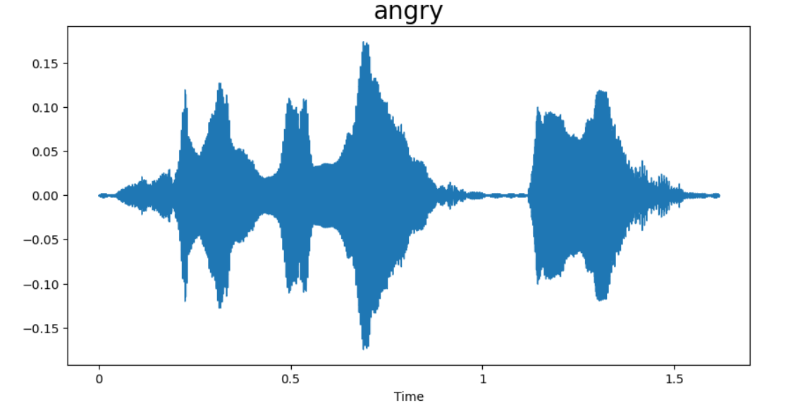
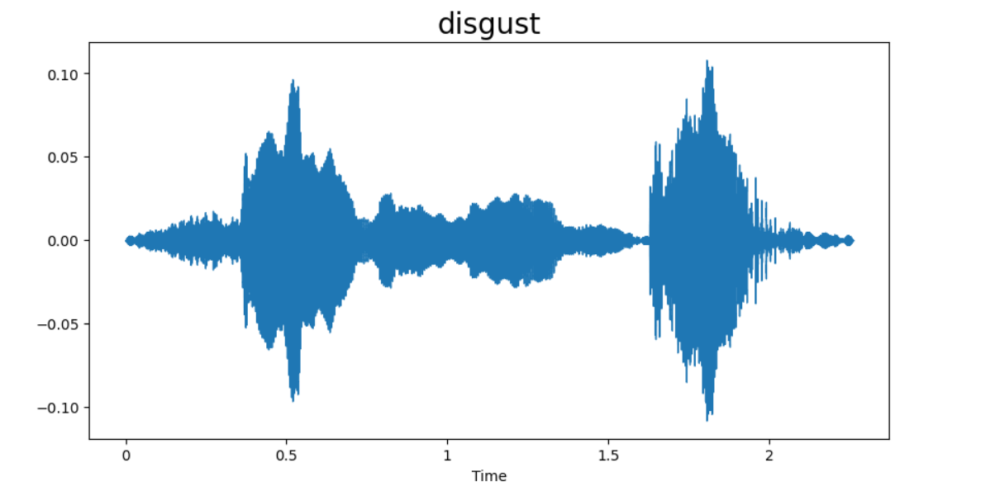
Data Pre-Processing
We conducted an exploratory data analysis (EDA) by employing the capabilities of the Librosa library to visualize the essence of each emotion within our dataset.
Wave Plot :-
Wave plots provided us with a visual representation of the temporal dynamics of each emotion, elucidating patterns and fluctuations over time.

Slide 12
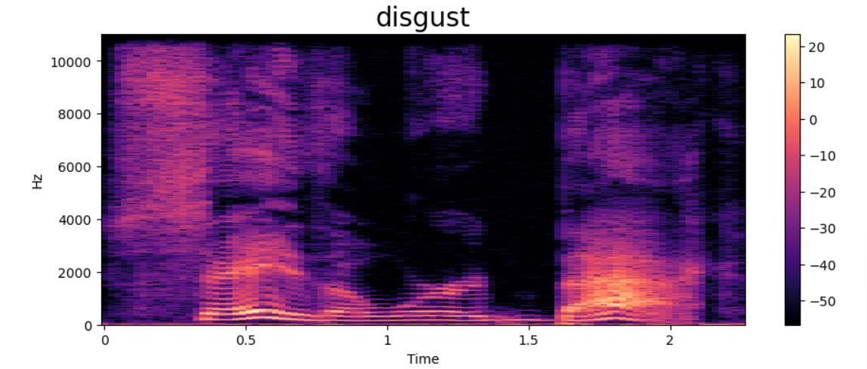
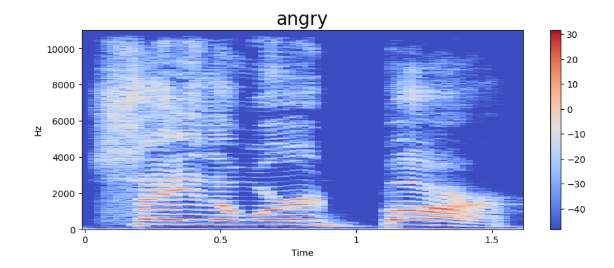
Data Pre-Processing
Spectrogram :-
Spectrograms, on the other hand, offered a deeper insight into the
frequency composition & spectral characteristics underlying the
distinct emotional expressions.

Slide 13

Data Pre-Processing
Audio Playback :-
Through audio playback, we immersed ourselves in the nuanced nuances of each emotion and transcending mere visual representation.

Slide 14
Data Pre-Processing
Feature Extraction
Through feature extraction, we've meticulously extracted Mel-Frequency Cepstral Coefficients (MFCCs) from each audio file within our dataset, seamlessly integrating them into their corresponding entries.
By incorporating MFCCs, which encapsulate essential acoustic characteristics, we've enriched our dataset with valuable features that encapsulate the nuanced auditory patterns underlying each emotion.

Slide 15
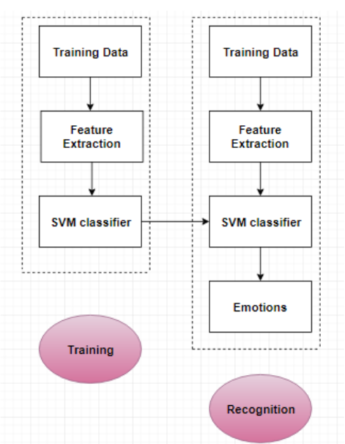
Methodology

Slide 16
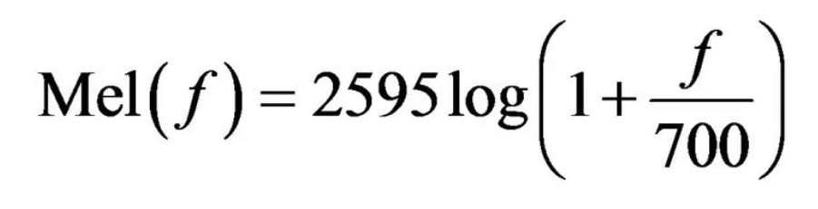
Methodology
MFCC Extraction:
MFCCs are computed from the speech signal to capture spectral characteristics.
These coefficients represent the short-term power spectrum of sound and are effective in capturing speech patterns.
The process involves dividing the speech signal into short frames, applying a filterbank to obtain the spectrum, taking the logarithm of the powers, and then applying the discrete cosine transform to obtain the MFCCs.
MFCCs provide a compact representation of the spectral envelope of speech, which contains valuable emotional information and voice patterns.
This simplified approach relies solely on MFCCs to extract features from the input voice sample, which are then fed into a classification system for emotion analysis.

Slide 17
Speech Emotion Recognition Techniques
Support Vector Machine (SVM)
Long Short-Term Memory(LSTM)

Slide 18
Support Vector System
The Support Vector Machine (SVM) algorithm was developed by a team of researchers including Vladimir Vapnik and Corinna Cortes in the early 1990s.
Definition : SVM is a supervised learning algorithm used for classification and regression analysis.
Main Goal: Find the hyperplane that best separates different classes in the feature space while maximizing the margin.
Key Features: SVM works well in high-dimensional spaces and is effective even when the number of dimensions exceeds the number of samples.

Slide 19

Basic Concepts of SVM

Slide 20
Basic Concepts of SVM
Support Vectors:
Support vectors are data points from the training dataset that lie closest to the decision boundary (hyperplane) between different classes.
These points play a crucial role in determining the optimal hyperplane and defining the margin.
Hyperplane:
In SVM, a hyperplane is a decision boundary that separates data points belonging to different classes in a high-dimensional space.
For binary classification, the hyperplane is a (d-1)-dimensional subspace in a d-dimensional feature space.
The goal of SVM is to find the hyperplane that maximizes the margin between the classes.

Slide 21
Basic Concepts of SVM
Margin:
The margin is the distance between the hyperplane and the nearest data points (support vectors) from each class.
In SVM, the objective is to maximize this margin, as it leads to better generalization and improved classification performance.
Larger margins indicate greater confidence in the classification decision.
Hard Margin SVM:
In a hard margin SVM, the objective is to find a hyperplane that perfectly separates the training data into different classes without any misclassifications.
This approach is sensitive to outliers and noisy data, as it requires the data to be linearly separable.
Hard margin SVMs may not be suitable for datasets with overlapping classes or noisy samples.
Soft Margin SVM:
In contrast to the hard margin SVM, a soft margin SVM allows for some misclassifications by introducing a penalty parameter (C).
The objective is to find a hyperplane that balances between maximizing the margin and minimizing the classification errors.

Slide 22
Types of Support Vector Classification
Linearly Separable Data:
Linearly separable data refers to a dataset in which two classes can be separated by a linear decision boundary (hyperplane) in the feature space.
Mathematically, if it's possible to draw a straight line, plane, or hyperplane that completely separates the data points of one class from those of the other class, the data is linearly separable.

Slide 23
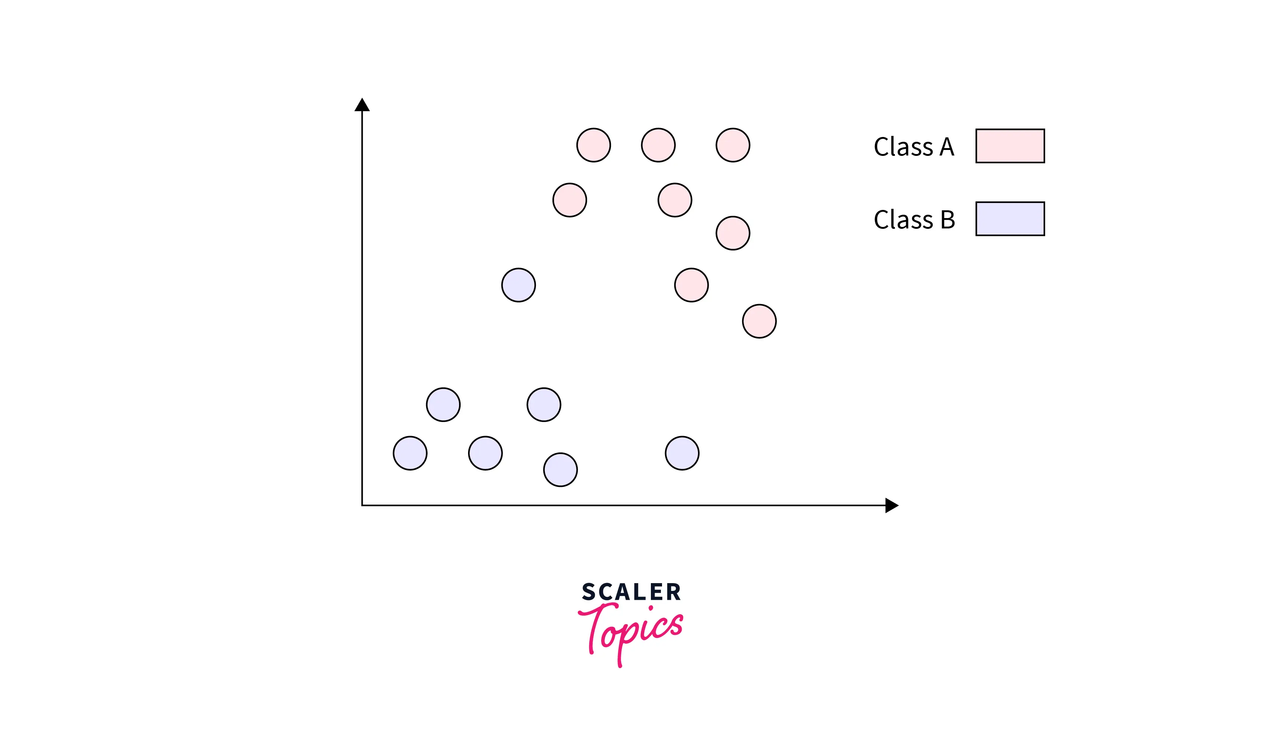
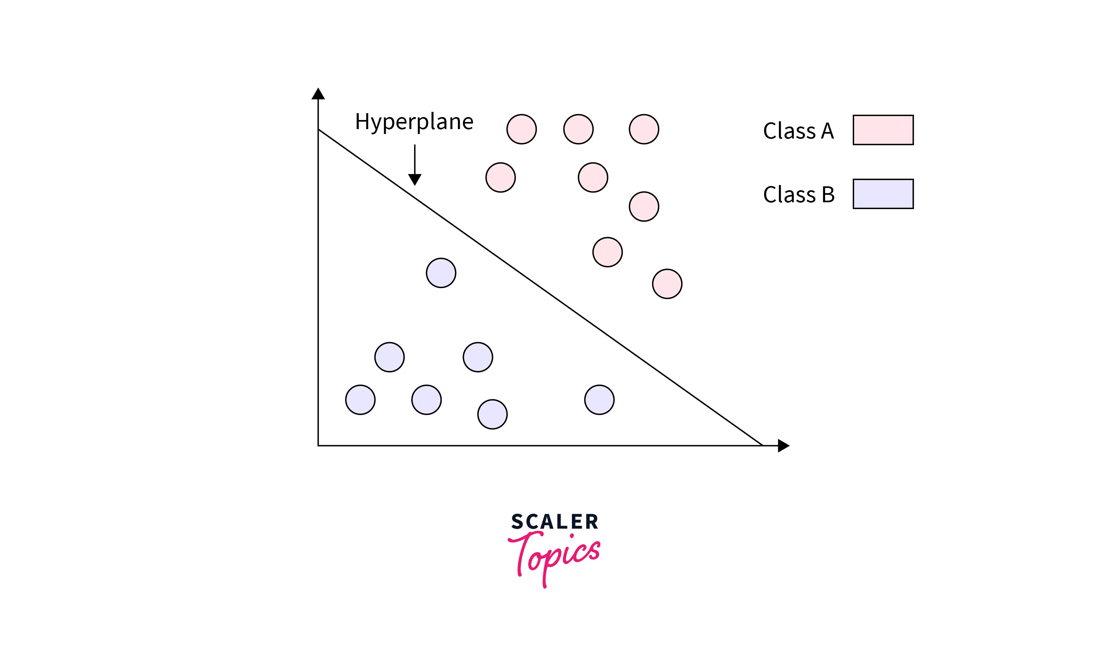
Linear SVM

Slide 24
Types of Support Vector Classification
2. Non-linearly Separable Data:
Non-linearly separable data refers to a dataset in which two classes cannot be separated by a linear decision boundary in the feature space.
Techniques like kernel trick, which implicitly map the data into a higher-dimensional space where it becomes linearly separable, are often used to handle non-linearly separable data.

Slide 25
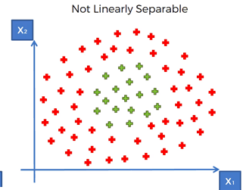
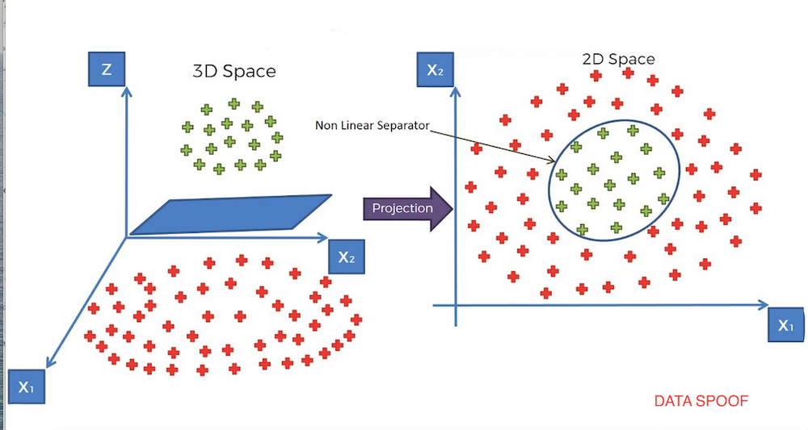
Non Linear SVM

Slide 26
Tuning Parameters of SVM
Regularization:
Regularization in SVM controls the trade-off between minimizing the training error and reducing model complexity.
It helps prevent overfitting by penalizing large coefficients in the decision function.
Gamma Parameter:
The gamma parameter in SVM determines the influence of individual training samples on the decision boundary.
A smaller gamma value results in a smoother decision boundary, while a larger gamma value leads to a more complex decision boundary that closely fits the training data.
Margin :
It is already shown in slide no-19.

Slide 27
Tuning Parameters of SVM
Kernel:
Kernel in SVM refers to a mathematical function that transforms input data into a higher-dimensional space, enabling SVM to handle non-linearly separable data by finding optimal hyperplanes in this transformed space.
Facilitates classification by implicitly mapping data to higher-dimensional spaces.
Avoids explicit computation of transformations, reducing computational complexity.
Enables SVM to model complex decision boundaries effectively.
Types of Kernel :
Linear Kernel: Computes dot product between input vectors.
Polynomial Kernel: Computes polynomial functions of features.
RBF (Radial Basis Function) Kernel: Maps data based on similarity using Euclidean distance.
Sigmoid Kernel: Utilizes hyperbolic tangent function, commonly found in neural network applications.

Slide 28
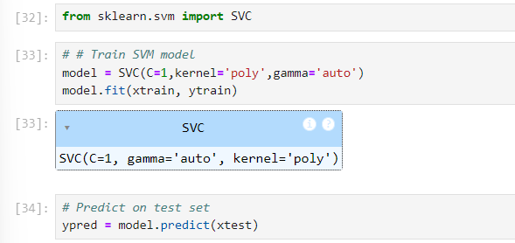
Implematation of SVM
The SVM model utilized in the project is sourced from the scikit-learn (sklearn) library.

Slide 29
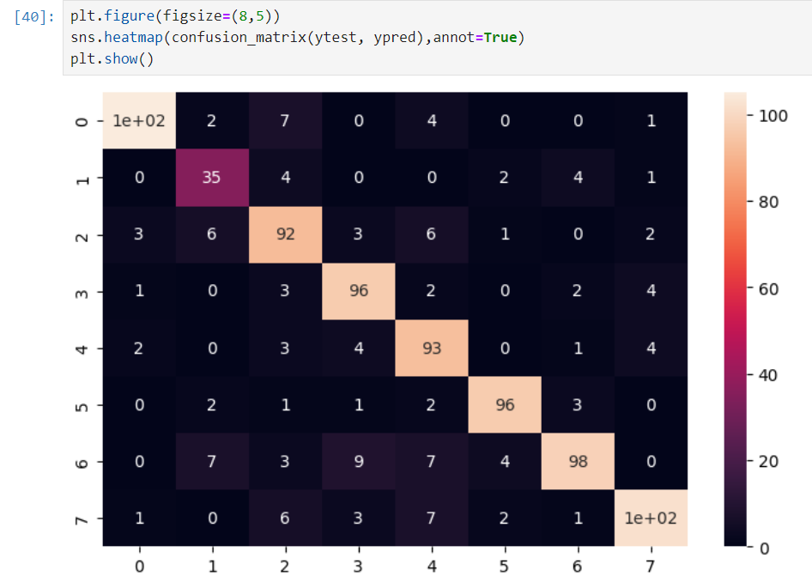
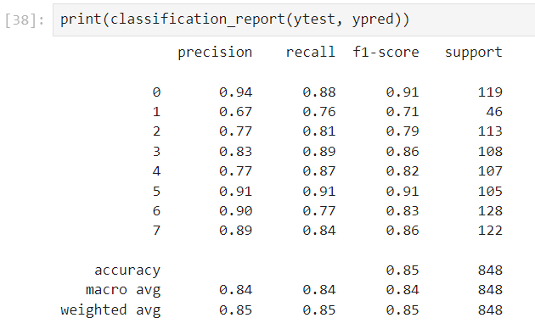
Performance Matrix

Slide 30
Why we select Support Vector Machine ?
Criteria | SVM | KNN | Decision Tree | Random Forest
Complexity and Computation | Efficient during prediction | Computationally expensive at prediction | Efficient at prediction, slow training | Efficient prediction, parallel training
Performance in High Dimensions | Handles high dimensions well with kernels | Performance degrades in high dimensions | Can struggle in high dimensions | Handles high dimensions well
Memory Usage | Stores only support vectors | Stores entire training dataset | Stores entire tree structure | Stores multiple tree structures
Overfitting | Less prone due to regularization | Prone to overfitting without tuning | Prone to overfitting, needs pruning | Less prone due to averaging
Optimization | Global optimization of hyperplane | No optimization, simple distance measure | Locally optimal decisions | Global optimization through averaging
Prediction Time | Fast: Uses a subset of support vectors. | Slow: Compares to all training instances. | Fast: Traverses a single tree. | Slower: Aggregates results from multiple trees.
Accuracy | 84% | 78% | 76% | 84%

Slide 31
Disadvantages of Support Vector Machine
Sensitivity to Noise
Computational Complexity
Difficulty in Interpretability

Slide 32
Long- short term memory
LSTM stands for Long Short-Term Memory, which is a type of recurrent neural network (RNN) architecture designed to overcome the limitations of traditional RNNs in capturing long-range dependencies in sequential data.

Slide 33
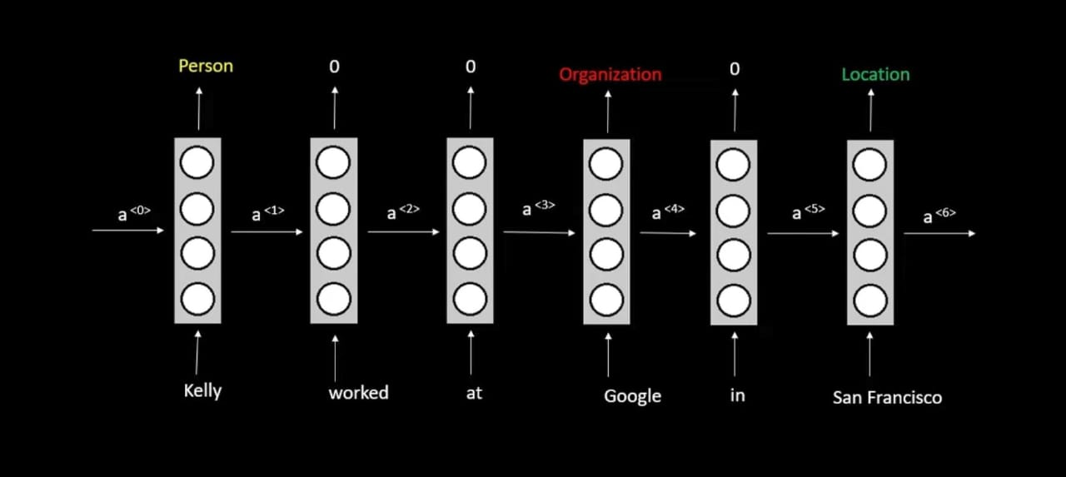
Concept of RNN
How It works?

Slide 34
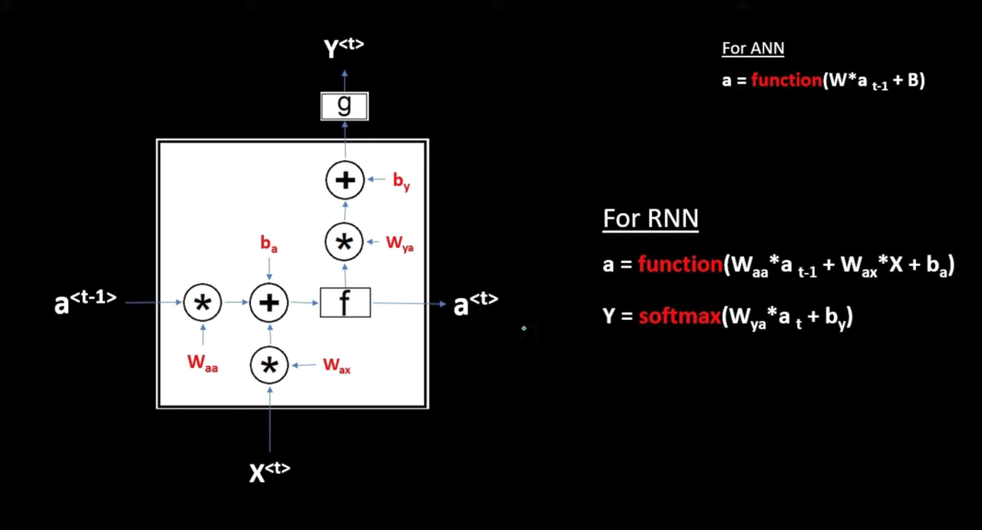
Concept of RNN

Slide 35
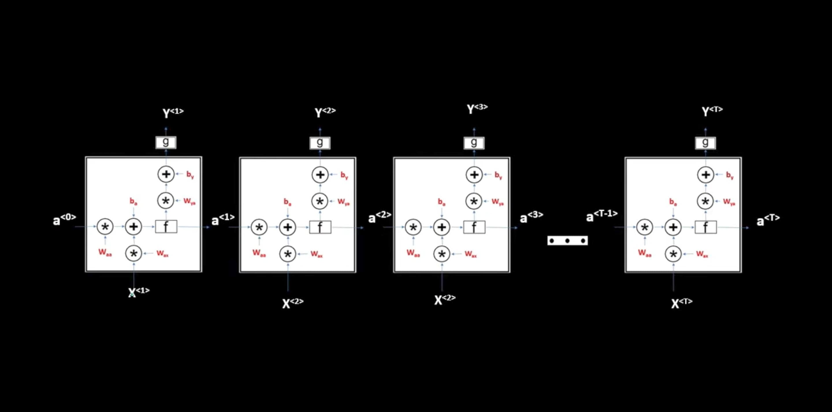
Concept of RNN

Slide 36
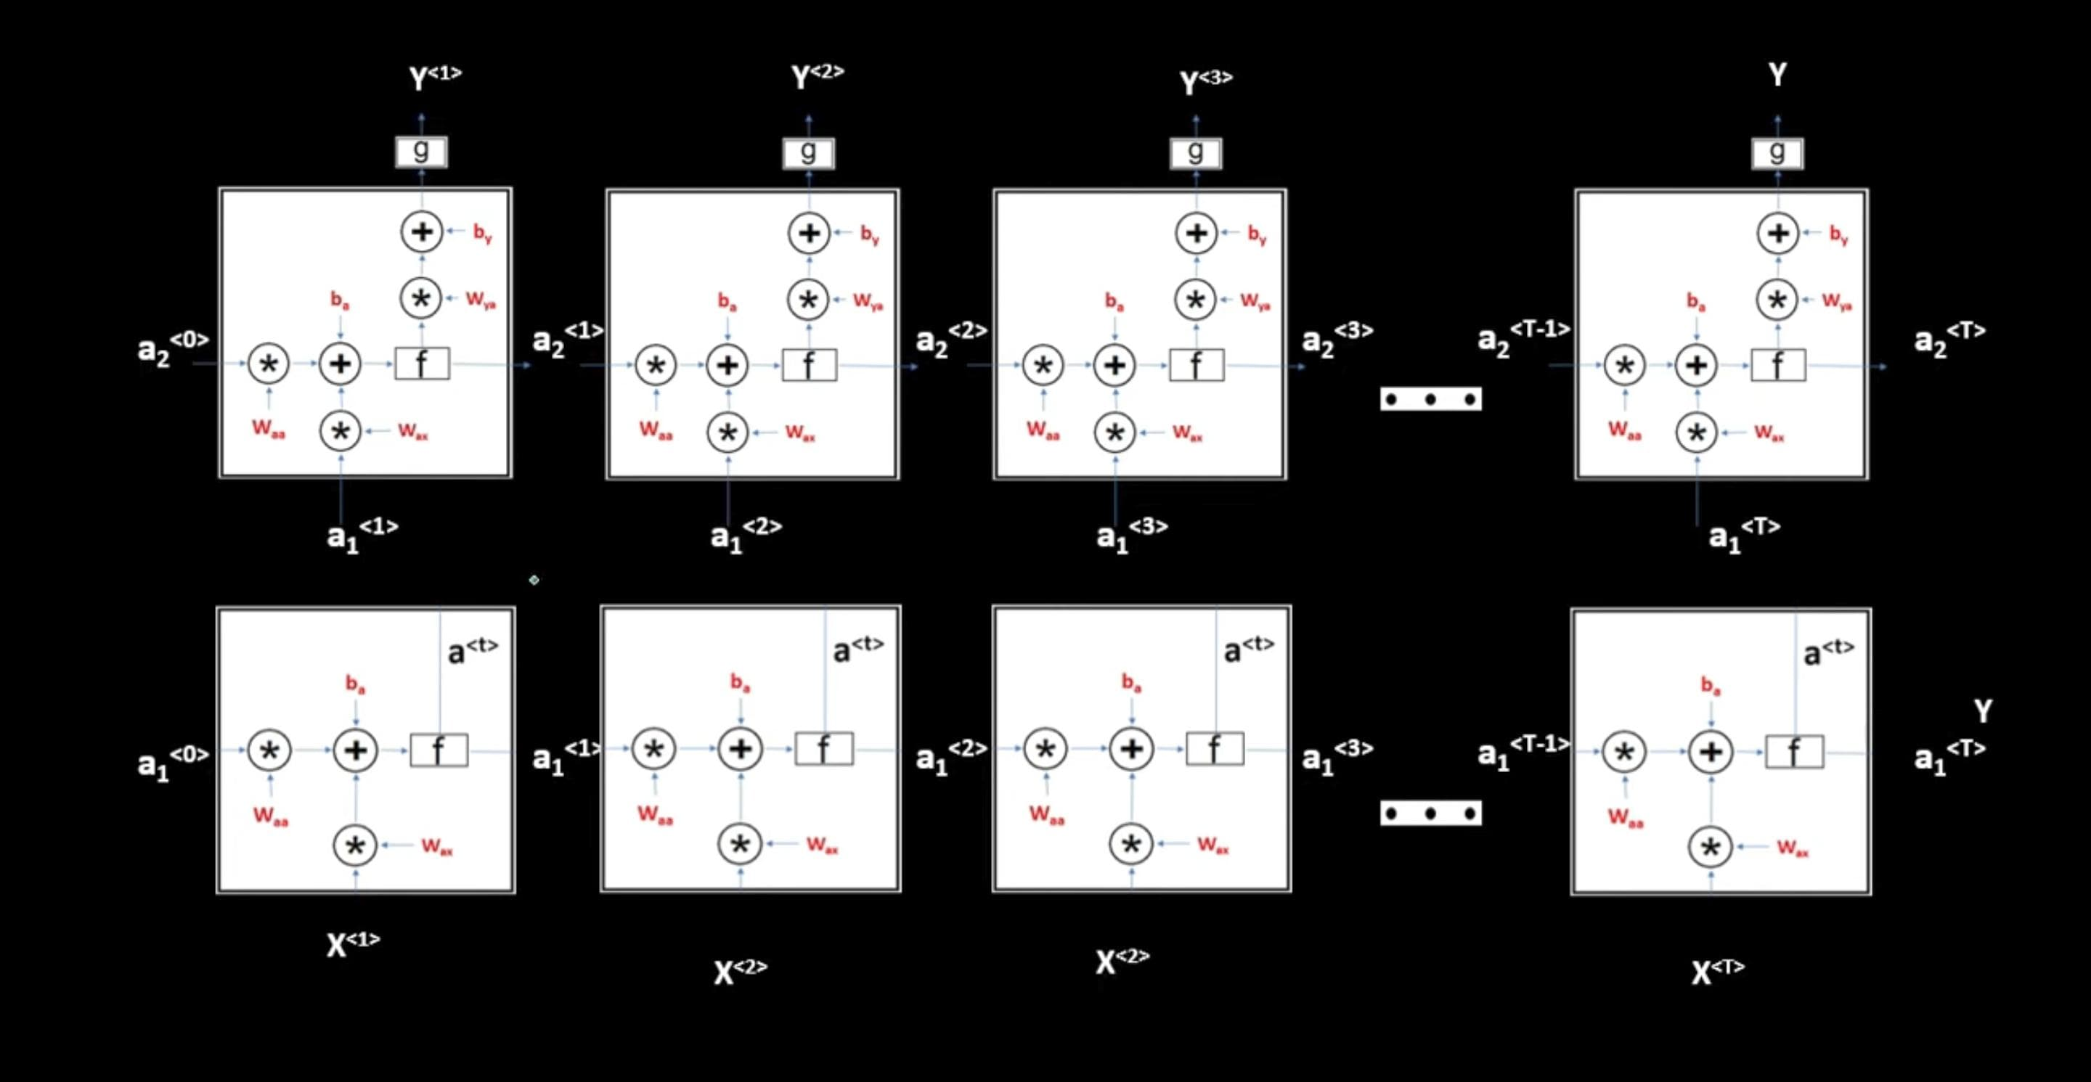
Concept of RNN

Slide 37
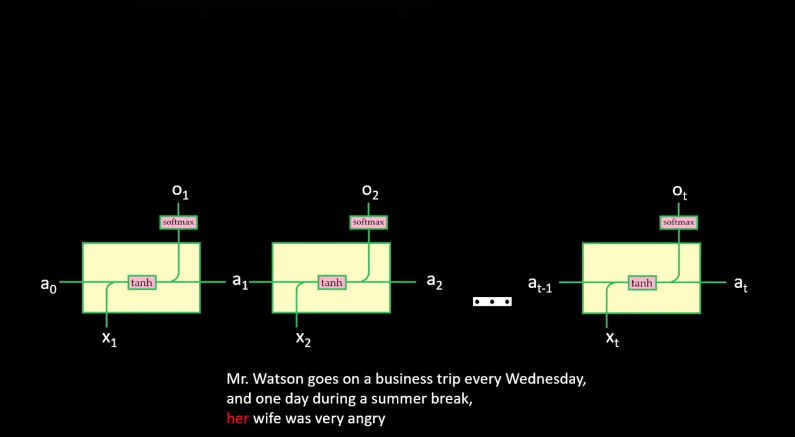
Problem with the Rnn

Slide 38
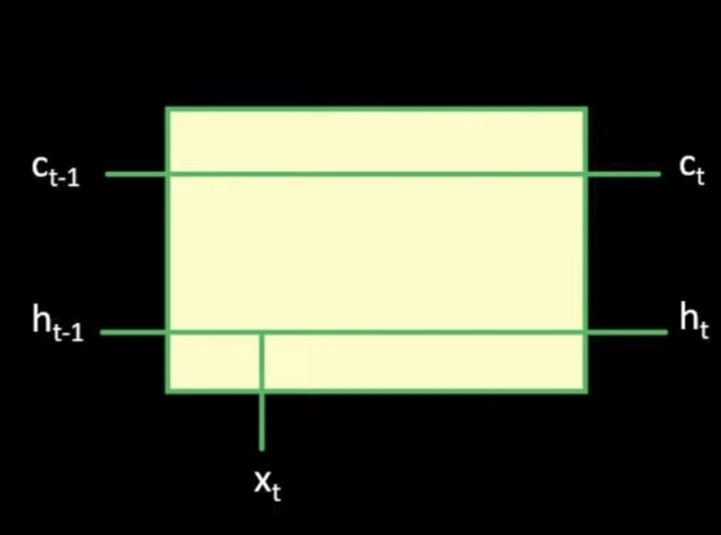
Long-Short Term Memory

Slide 39
Types of gates
1. Forget Gate
2. Input Gate
3. Output Gate

Slide 40
Forget Gate
Purpose: Determines which information from the previous cell state (ct-1 ) to forget or retain.
Activation: Sigmoid function outputting values between 0 (completely forget) and 1 (completely retain) for each element in the cell state.

Slide 41
Input Gate
Purpose: Decides which new information to store in the cell state.
Activation: Two parts controlled by sigmoid and tanh functions.

Slide 42
Output Gate
Purpose: Controls what information to output as the hidden state.
Activation: Sigmoid and tanh functions.

Slide 43
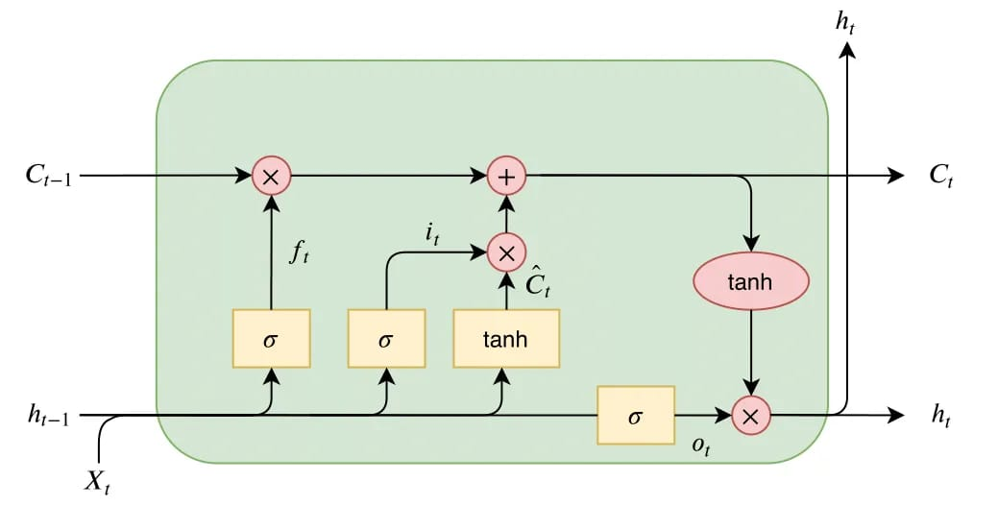
LSTM

Slide 44
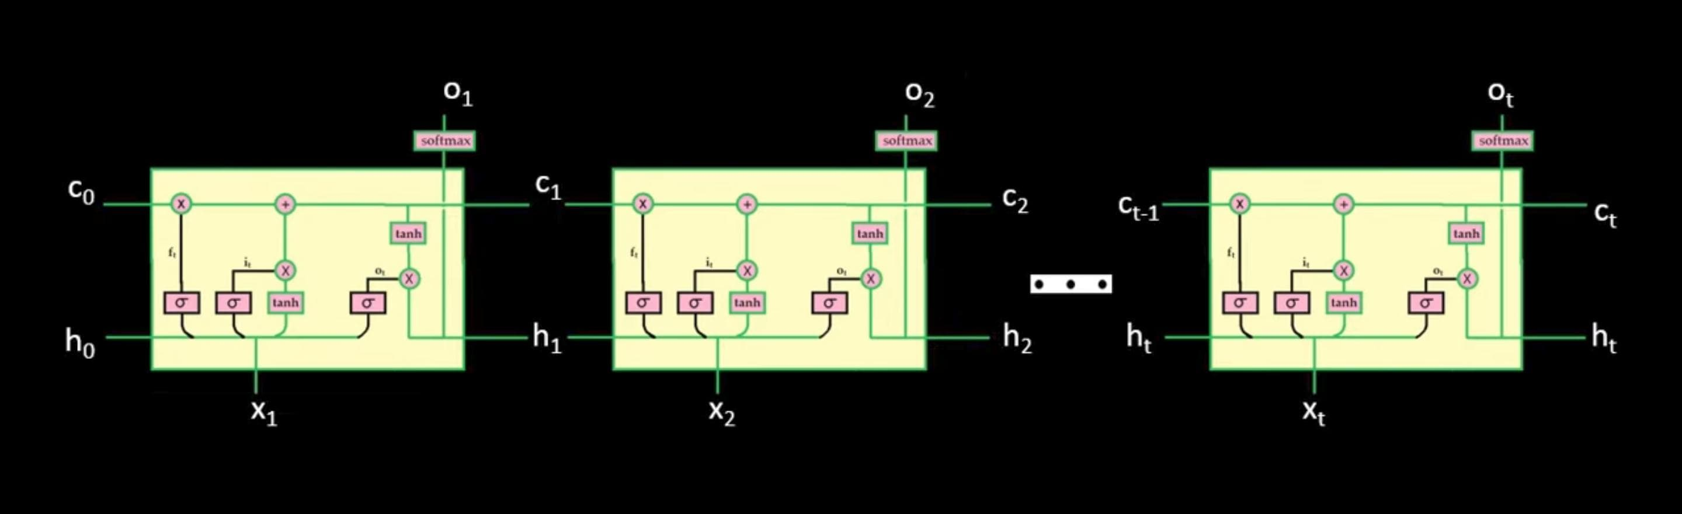

Slide 45
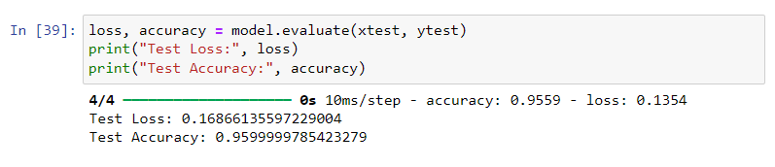
Test Loss and Test Accuracy

Slide 46
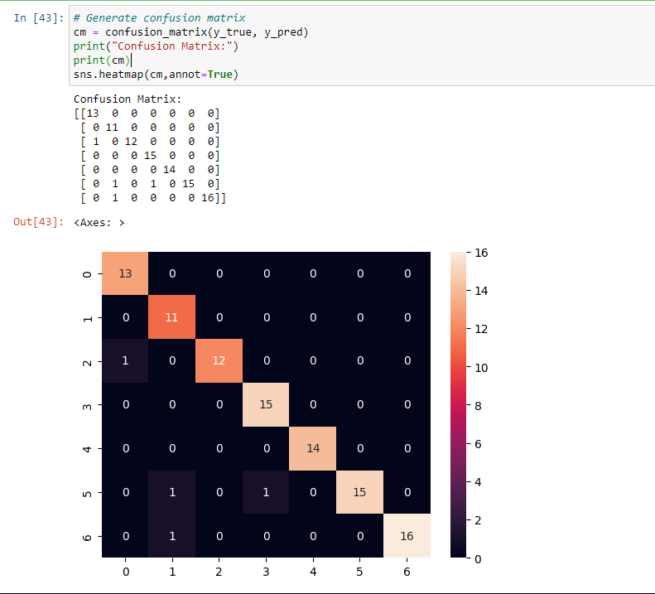
Confusion Matrix

Slide 47
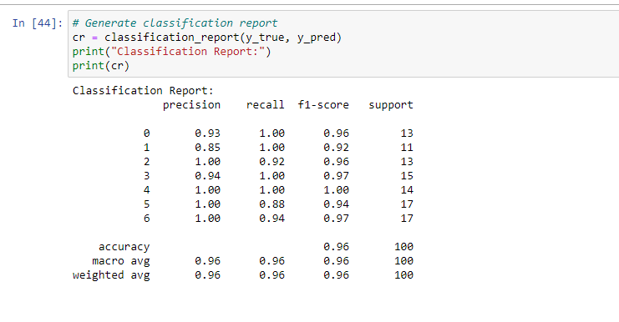
Classification Report

Slide 48
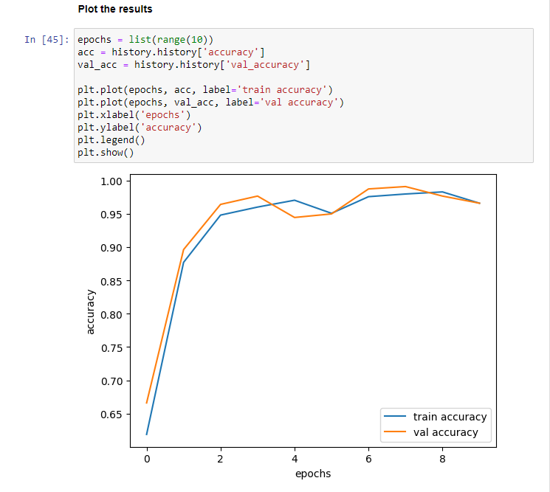
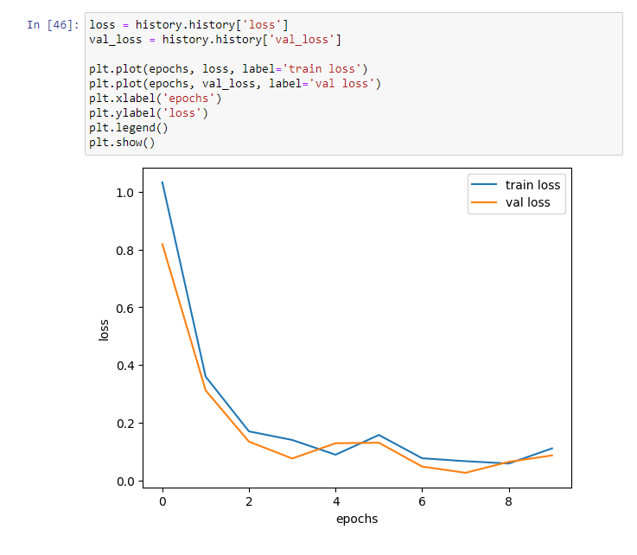

Slide 49
Thank You!

